Slide 1
A MAJOR PROJECT On Automating Cyberbullying Detection using Char-level Deep Learning model BY G HEMANTH REDDY

Slide 2
Contents
Abstract
Problem Statement
Literature Survey
Existing System and Disadvantages
Proposed System and Advantages
System Requirements
Modules
Design (Architecture and UML diagrams)
Code
Testing
Conclusion
Future Scope
References

Slide 3
Abstract
Cyberbullying is the process in which a person on the internet uses social media or other online platforms to be mean or hurtful to others. They might send harmful messages, share threats, or spread rumours. Cyberbullying has become a major concern in today's society, with many individuals being subjected to various forms of online harassment and abuse. Traditional methods of identifying cyberbullying have proven to be inadequate due to the complexity and constantly evolving nature of this issue.
Deep learning has shown great promise in automating the detection of cyberbullying by analysing large amounts of text and identifying patterns and characteristics that indicate abusive behaviour. This presentation will delve into the most efficient deep learning algorithm used for cyberbullying detection, such as convolutional neural networks (CNNs).

Slide 4
Problem Statement
Bullying based on race, religion, gender, caste can cause an adverse effect on the victim’s mental health, eventually leading to anxiety, depression, and even suicide attempts. Human monitoring becomes fruitless in the face of such huge amounts of data on the internet. Thus, there is a need to tackle this problem on an automated level that is fast, efficient, and accurate for the sake of social well-being.

Slide 5
Literature Survey
Title | Author | Year | Algorithms | Accuracy
An Application to Detect Cyberbullying Using Machine Learning Techniques | Mitushi Raj, Samridhi Singh, Kanishka Solanki, Ramani Selvanambi | 2022 | Bi-LSTM CNN | 91%

Slide 6
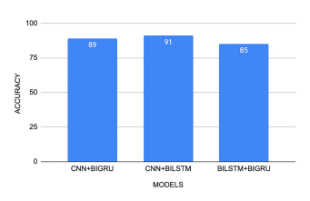
Existing System and Disadvantages
An existing system for cyberbullying detection uses Bi-LSTM CNN, which stands for Bi-directional Long Short-term Memory, is a neural network that can remember and make decisions based on previous information in the sequence. Bi-LSTM is a combination of both forward and backward LSTM, such combination helps in understanding relationship between words in a sequence.

Slide 7
Existing System and Disadvantages (contd.)
Disadvantages:
Lack of real-time processing
Higher computational complexity
Requires more memory as information from both directions to be stored.

Slide 8
Proposed System and Advantages
Our research focuses on textual cyberbullying detection where the content information is short, noisy, and with incorrect spellings and symbols, and this impacts the performance of some traditional machine learning methods. For this reason, we propose a Char-CNN (Character-level Convolutional Neural Network) model to identify whether the text in social media contains cyberbullying. We use characters as the smallest unit of learning, enabling the model to overcome spelling errors and errors in symbols in real-world application.

Slide 9
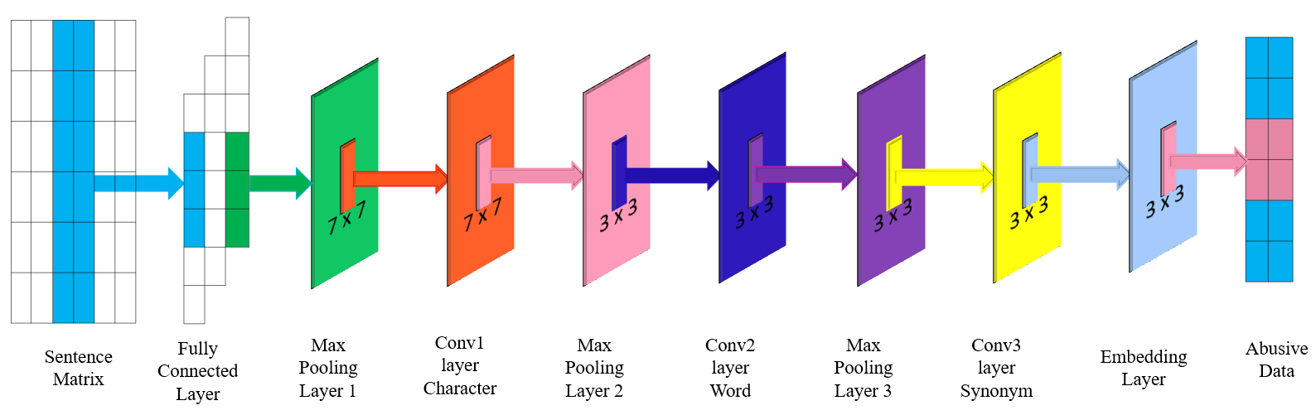
Proposed System and Advantages (contd.)
Advantages:
Char-level CNN is better for classifying unstructured text (spelling errors, abbreviations, etc.) in social media.
Requires less computational time complexity.
Comparatively more accurate as character-level analysis is performed (accuracy is 95.8%)

Slide 10
System Requirements
Software Requirements
Python IDLE 3.7 version (or)
Anaconda 3.7 (or)
Jupiter (or)
Google colab
Hardware Requirements
Operating system : Windows, Linux
Processor : intel i3 (minimum)
Ram : 4 GB (minimum)
Hard disk : 250GB (minimum)

Slide 11
Modules
Upload Dataset: Using this module text-based dataset can be uploaded to application.
Clean Module: Using this module we will apply various NLP techniques to remove stop words, special symbols etc.
Generate Vocabulary and Embedding Vector: using this module we will build vocabulary with all English characters set. Convert all text-based data to numeric by obtaining text numeric value from vocabulary and build a training vector.
Generate Character Based CNN Model: Using this module we will create CNN layers with vocabulary input and output sizes and then give train data as input to build CNN model.
Metrics Calculation: Using this module we will calculate various metric such as ACCURACY, PRECISION, RECALL and FMEASURE.
6) Predict Cyberbullying: Using this module we will ask user to enter any text message and then apply pre-processing technique to clean text and then convert text into one hot encoding or numeric vector. This numeric vector will be applied on CNN trained model to predict whether text contains any cyber bulling words or not.

Slide 12
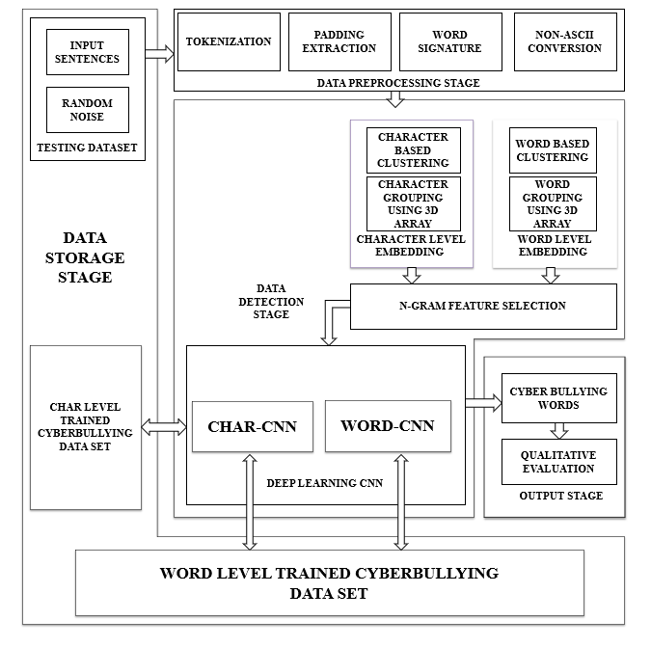
Design
Architecture

Slide 13
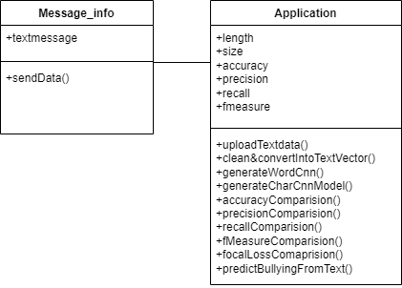
Design (contd.)
UML Diagrams:
Class Diagram
Class diagram in the Unified Modeling Language (UML) is a type of static structure diagram that describes the structure of a system by showing the system’s classes, their attributes, operations (or methods), and the relationships among the classes.

Slide 14
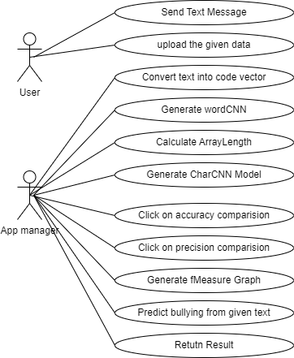
Design (contd.)
UML Diagrams:
Use Case Diagram
A use case diagram in the Unified Modeling Language (UML) is a type of behavioral diagram defined by and created from a Use-case analysis. Its purpose is to present a graphical overview of the functionality provided by a system in terms of actors, their goals (represented as use cases), and any dependencies between those use cases.

Slide 15
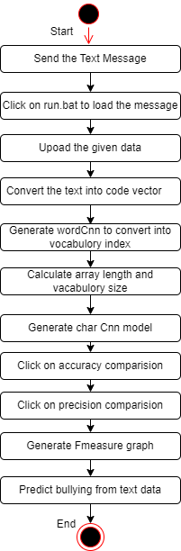
Design (contd.)
UML Diagrams:
Activity Diagram
The process flows in the system are captured in the activity diagram. An activity diagram consists of activities, actions, transitions, initial and final states.

Slide 16
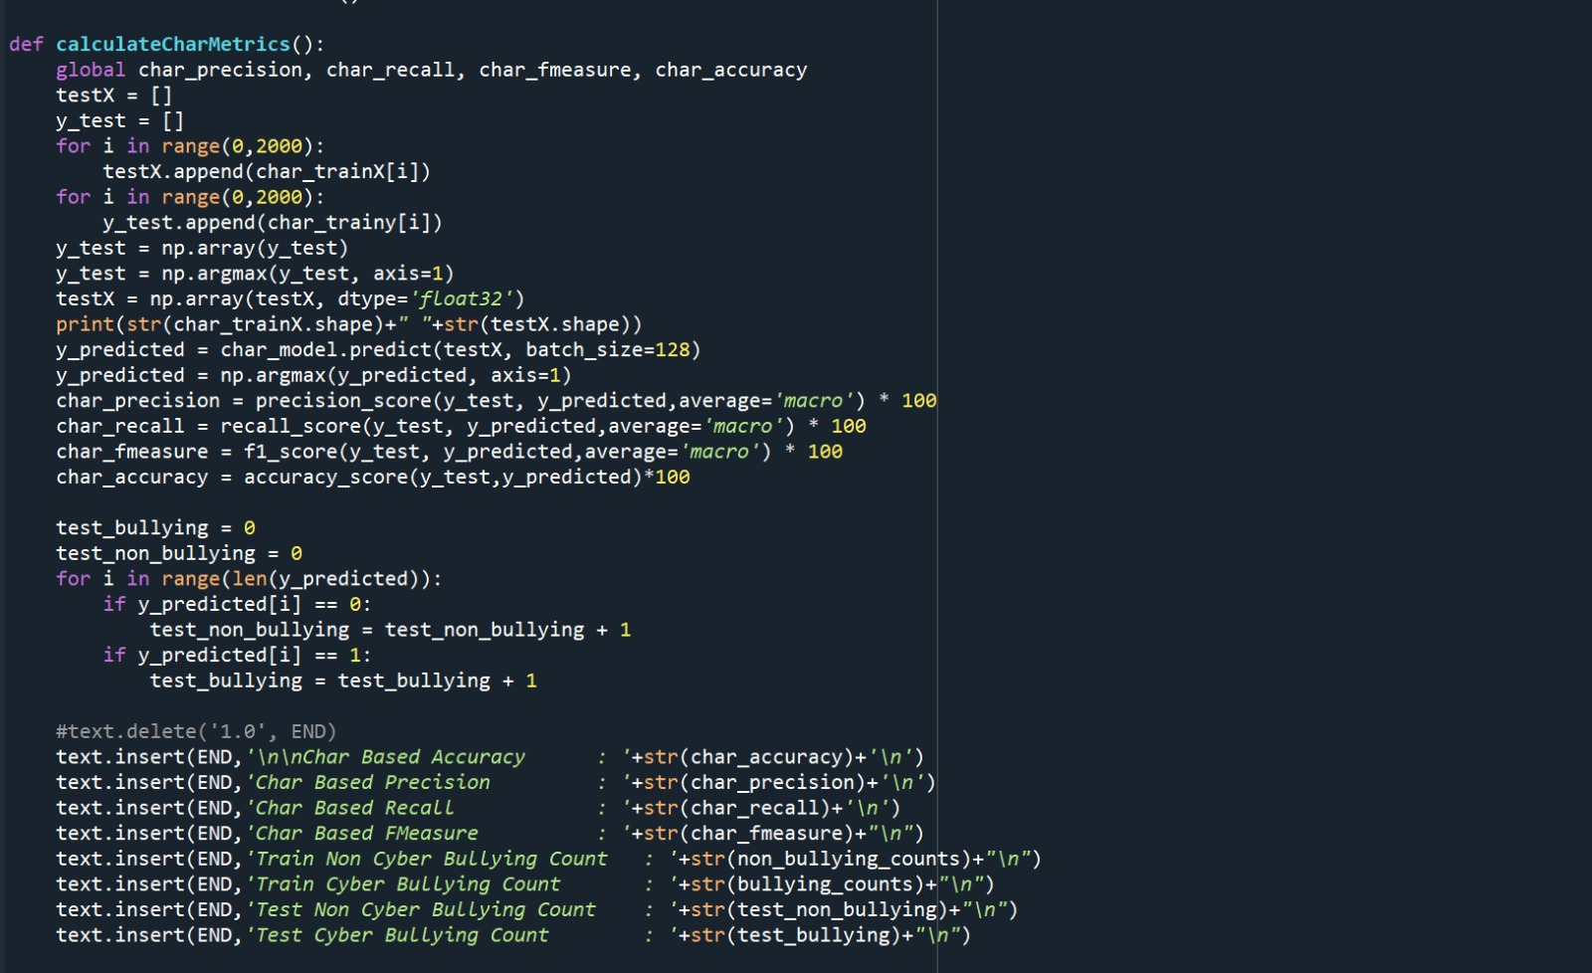
Code

Slide 17
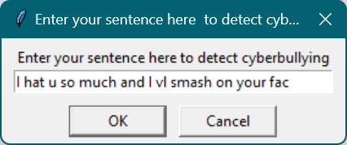
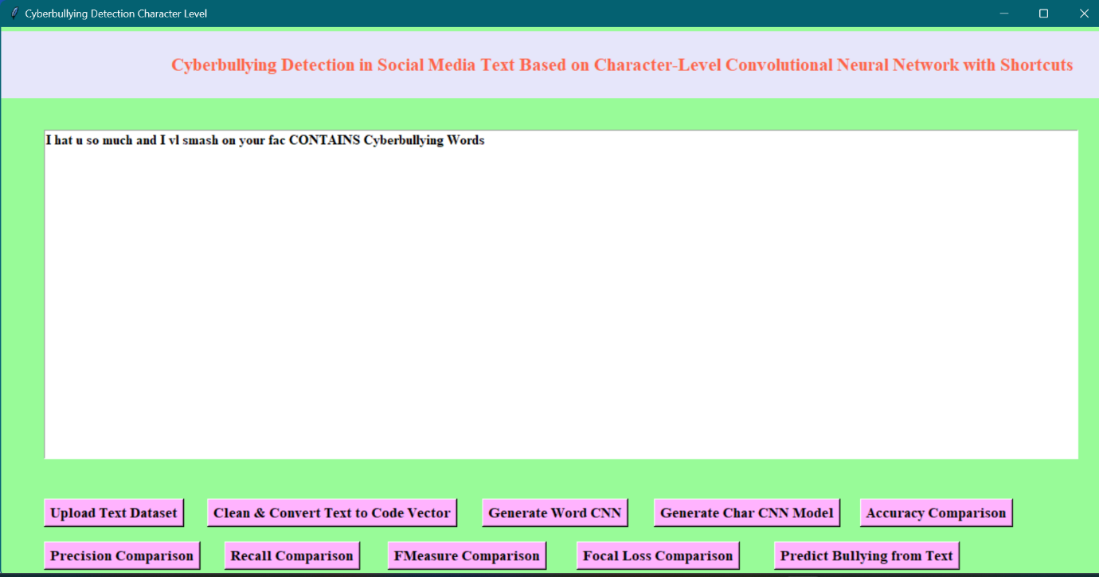
Output

Slide 18
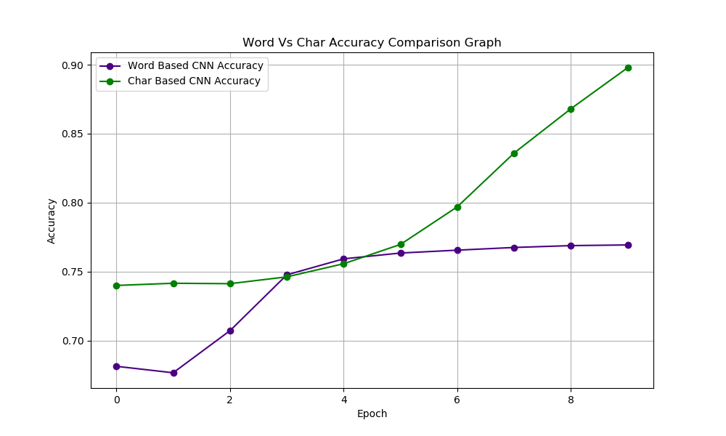
Output (contd.)

Slide 19
Testing
Test cases:
Test case ID | Test case name | Purpose | Input | Output
1 | Recognition test 1 | To check if the detector performs its task | A normal text in the form of a social media comment is given | It detected as non-bully text.
2 | Recognition test 2 | To check if the detector performs its task | A threat comment in the form of a social media comment is given | It detected as bullying text.

Slide 20
Conclusion
Cyberbullying is a serious issue that can have devastating effects on individuals and society as a whole. Therefore, effective methods for detecting and predicting cyberbullying are essential to prevent its harmful consequences. The use of deep learning models such as word-based and char based CNNs with shortcuts has shown promising results in accurately identifying instances of cyberbullying. These models utilize the power of natural language processing and deep learning techniques to analyse text data and classify it as either cyberbullying or non-cyberbullying. By incorporating shortcut connections, these models can learn complex features and relationships in the text data, enabling them to accurately predict and classify instances of cyberbullying.
Overall, the development of effective cyberbullying detection and prediction models is crucial in the fight against this harmful behaviour. With further research and development, word-based and char based CNNs with shortcuts have the potential to become even more accurate and reliable in detecting and predicting cyberbullying, ultimately leading to a safer and more positive online environment for everyone.

Slide 21
Future Scope
Expand the dataset: We can consider collecting a larger and more diverse dataset for training the model, where the input may consist of both images and text.(symbolic image based cyberbullying). A larger dataset can help improve the model's generalization.

Slide 22
References
Reynolds K, Kontostathis A, Edwards L. Using machine learning to detect cyberbullying. Paper presented at: 10th International Conference on Machine learning and Applications and Workshops; 2021; Honolulu, HI.
Kasture AS. A predictive model to detect online cyberbullying [master's thesis]. Auckland, New Zealand: Auckland University of Technology; 2019.
Dadvar M, Ordelman R, de Jong F, Trieschnigg D. Improved cyberbullying detection using gender information. Paper presented at: 12th Dutchbelgian Information Retrieval Workshop; 2020; Ghent, Belgium.
Dinakar K, Reichart R, Lieberman H. Modeling the detection of textual cyberbullying. Paper presented at: 5th International AAAI Conference on Weblogs and Social Media; 2020; Barcelona, Spain.
Ying C, Zhou Y, Zhu S, Xu H. Detecting offensive language in social media to protect adolescent online safety. Paper presented at: 2021 International Conference on Privacy, Security, Risk and Trust and 2012 International Conference on Social Computing; 2021; Amsterdam, Netherlands.
Zhao R, Mao K. Cyberbullying detection based on semantic-enhanced marginalized denoising auto-encoder. IEEE Trans Affect Comput. 2020;8(3):328-339.
Lin TY, Goyal P, Girshick R, He K, Dollar P. Focal loss for dense object detection. IEEE Trans Pattern Anal Mach Intell. 2021;99:2999-3007.

Slide 23
Queries?

